Slide 1

SCS1301 - OPERATING SYSTEM
UNIT – 1
INTRODUCTION TO OS
Ms. B KEERTHI SAMHITHA
ASSISTANT PROFESSOR
DEPARTMENT OF CSE
SCHOOL OF COMPUTING

Slide 2
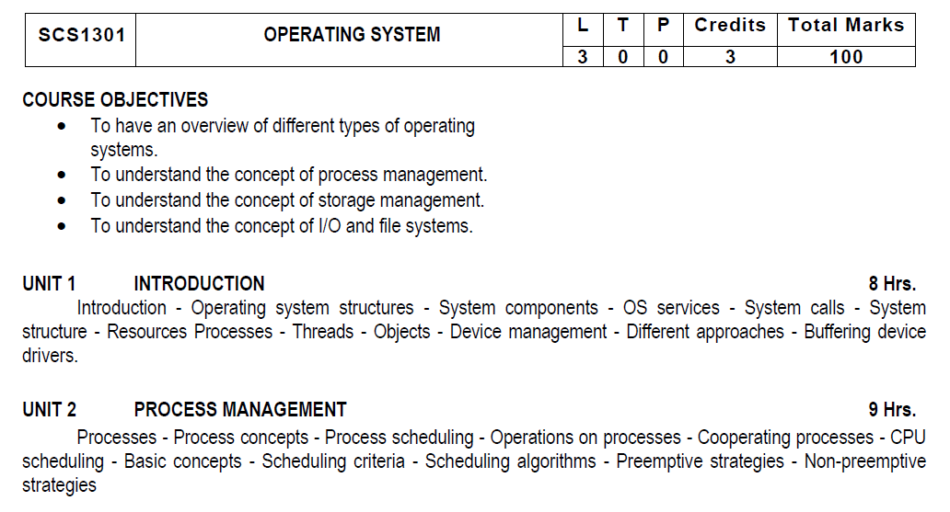

Slide 3
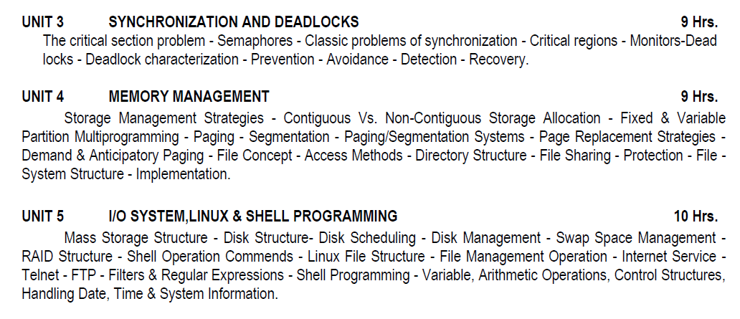

Slide 4
COURSE
OUTCOMES
SCS1301.1 | Comprehend knowledge about Operating system components and services.
SCS1301.2 | Apply knowledge of process scheduling algorithms for a given context.
SCS1301.3 | Analyze process synchronization and deadlock conditions.
SCS1301.4 | Construct the process of Mapping logical address to physical address.
SCS1301.5 | Design appropriate strategies for Paging, Segmentation.
SCS1301.6 | Develop real time applications Based on Linux shell programming.

Slide 5
INTRODUCTION TO OS
A computer system has many resources (hardware and software), which may be require to complete a task.
Operating System is a system software that acts as an intermediary between a user and Computer Hardware to enable convenient usage of the system and efficient utilization of resources.
The commonly required resources are input/output devices, memory, file storage space, CPU etc.
The operating system acts as a manager of the above resources and allocates them to specific programs and users, whenever necessary to perform a particular task.
The resources are processor, memory, files, and I/O devices. In simple terms, an operating system is the interface between the user and the machine.
Therefore operating system is the resource manager i.e. it can manage the resource of a computer system internally.

Slide 6
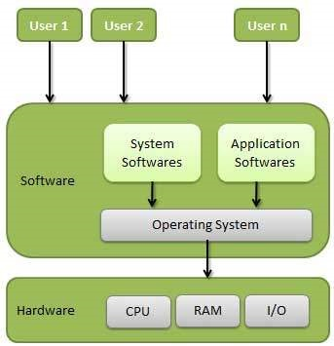
INTRODUCTION TO OS

Slide 7
GOALS OF OPERATING SYSTEM
Execute user programs
Make solving user problems easier.
Make the computer system convenient to use.
Use the computer hardware in an efficient manner.

Slide 8
FUNCTIONS OF OPERATING SYSTEM / SYSTEM COMPONENTS
Main Memory Management
Processor Management
Device Management
File Management
I/O System Management
Secondary Management
Networking
Protection System
Command Interpreter System

Slide 9
MEMORY MANAGEMENT
Memory management refers to management of Primary Memory or Main Memory. Main memory is a large array of words or bytes where each word or byte has its own address.
Main memory provides a fast storage that can be accessed directly by the CPU.
ACTIVITIES
Keeps tracks of primary memory, i.e., what part of it are in use by whom, what part is not in use.
In multiprogramming, the OS decides which process will get memory when and how much.
Allocates the memory when a process requests it to do so.
De-allocates the memory when a process no longer needs it or has been terminated

Slide 10
PROCESSOR MANAGEMENT
In multiprogramming environment, the OS decides which process gets the processor when and for how much time. This function is called process scheduling
ACTIVITIES
Keeps tracks of processor and status of process. The program responsible for this task is known as traffic controller.
Allocates the processor (CPU) to a process.
De-allocates processor when a process is no longer required.

Slide 11
DEVICE MANAGEMENT
An Operating System manages device communication via their respective drivers
ACTIVITIES
Keeps tracks of all devices. Program responsible for this task is known as the I/O controller.
Decides which process gets the device when and for how much time.
Allocates the device in the efficient way.
De-allocates devices.

Slide 12
FILE MANAGEMENT
A file system is normally organized into directories for easy navigation and usage. These directories may contain files and other directions.
ACTIVITIES
Keeps track of information, location, uses, status etc. The collective facilities are often known as file system.
Decides who gets the resources.
Allocates the resources.
De-allocates the resources

Slide 13
I/O SYSTEM MANAGEMENT
OS hides the peculiarities of specific hardware devices from the user.
ACTIVITIES
A memory management component that includes buffering, caching and spooling.
A general device-driver interface
Drivers for specific hardware devices.
Only the device driver knows the peculiarities of the specific device to which it is assigned.

Slide 14
SECONDARY STORAGE MANAGEMENT
The main purpose of a computer system is to execute programs. These programs, with the data they access, must be in main memory, or primary storage.
Systems have several levels of storage, including primary storage, secondary storage and cache storage.
ACTIVITIES
Free-space management (paging/swapping)
Storage allocation (what data goes where on the disk)
Disk scheduling (Scheduling the requests for memory access).

Slide 15
NETWORKING
A distributed systems are a collection of processors that do not share memory, peripheral devices, or a clock.
The processors in the system are connected through a communication-network. Communication takes place using a protocol. The network may be fully or partially connected
The communication-network design must consider routing and connection strategies.
ACTIVITIES
Computation Speed-up
Increased functionality
Increased data availability
Enhanced reliability

Slide 16
PROTECTION SYSTEM
If a computer system has multiple users and allows the concurrent execution of multiple processes, then the various processes must be protected from one another's activities.
Protection refers to mechanism for controlling the access of programs, files, memory segments, processes (CPU) only by the users who have gained proper authorization from the OS.
ACTIVITIES
Distinguish between authorized and unauthorized usage.
Specify the controls to be imposed.
Provide a means of enforcement.

Slide 17
COMMAND INTERPRETER SYSTEM
A command interpreter is one of the important system programs for an OS.
It is an interface of the operating system with the user. The user gives commands, which are executed by Operating system (usually by turning them into system calls).
The main function of a command interpreter is to get and execute the next user specified command.
ACTIVITIES
process creation and management
I/O handling
secondary-storage management
main-memory management
file-system access
protection
networking

Slide 18
CLASSIFICATION OF OPERATING SYSTEM
Multi-user OS : Allows two or more users to run programs at the same time.
Multiprocessing OS : Support a program to run on more than one central processing unit (CPU) at a time.
Multitasking OS : Allows to run more than one program at a time
Multithreading OS : Allows different parts of a single program to run concurrently (simultaneously or at the same time).
Real time OS : These are designed to allow computers to process and respond to input instantly

Slide 19
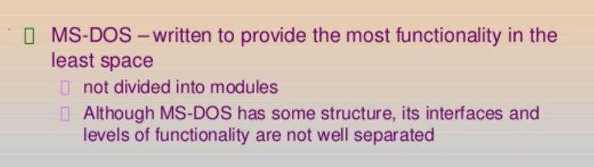
OPERATING SYSTEM STRUCTURES
A SIMPLE STRUCTURE: There are many operating systems that have a rather simple structure.
These started as small systems and rapidly expanded much further than their scope. A common example of this is MS-DOS.
MS – DOS SYSTEM STRUCTURE

Slide 20
MS – DOS Structure
Application Programming
Resident System Programming
MS-DOS Drivers
ROM - BIOS Device Drivers

Slide 21
LAYERED STRUCTURE
One way to achieve modularity in the operating system is the layered approach. In this, the bottom layer is the hardware and the topmost layer is the user interface.

Slide 22
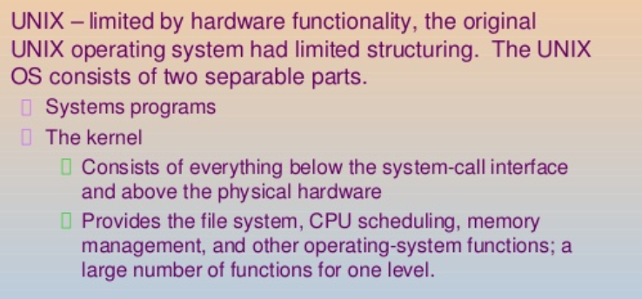
UNIX STRUCTURE

Slide 23
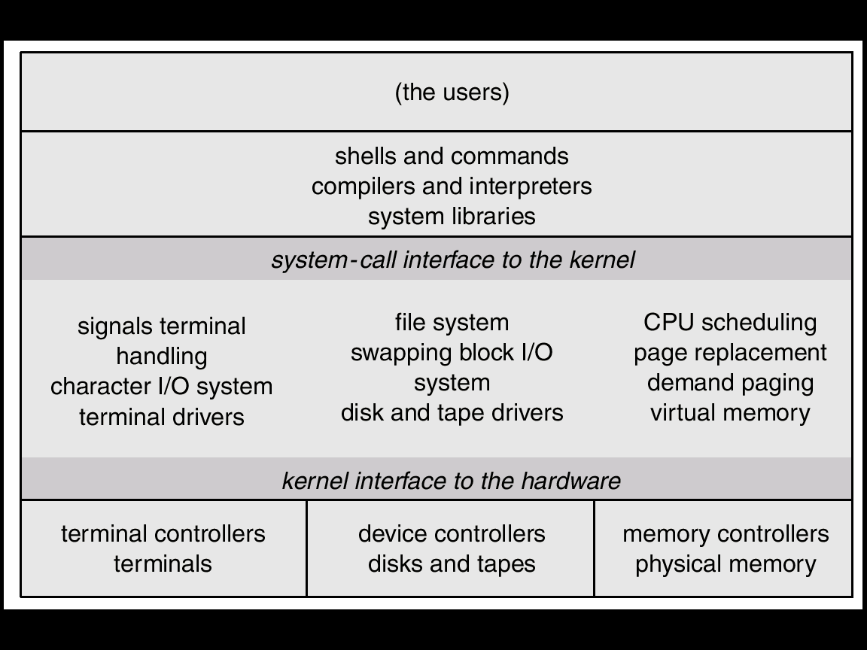
UNIX

Slide 24
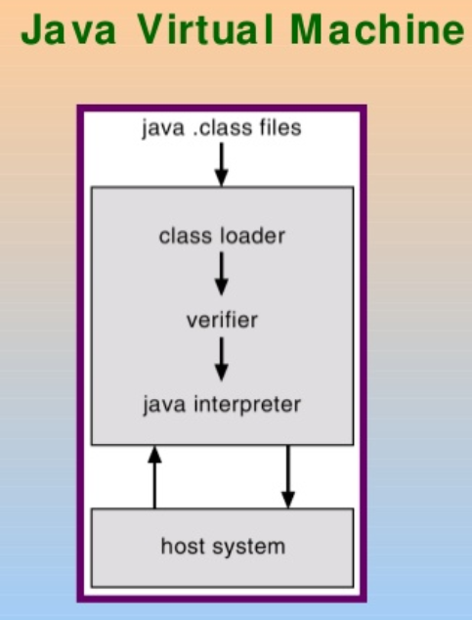
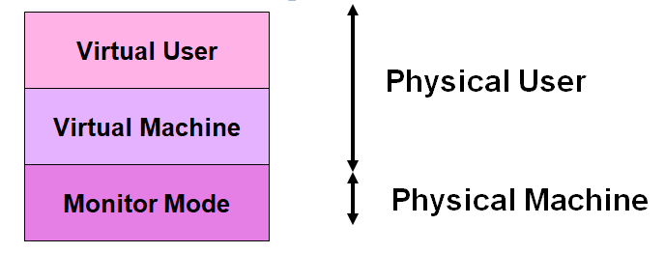
VIRTUAL MACHINE
In a Virtual Machine - each process "seems" to execute on its own processor with its own memory, devices, etc.
The resources of the physical machine are shared. Virtual devices are sliced out of the physical ones. Virtual disks are subsets of physical ones.

Slide 25
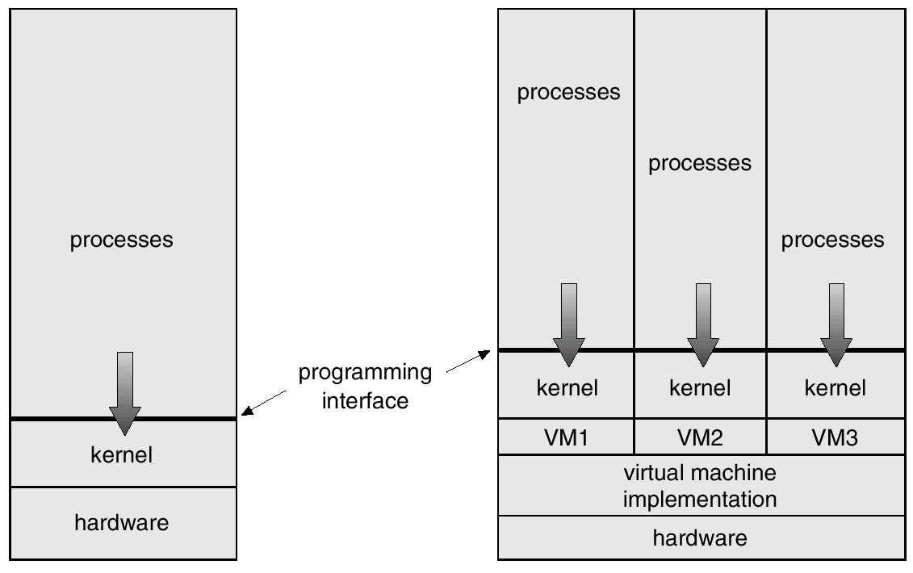
VIRTUAL MACHINE

Slide 26
OPERATING SYSTEM SERVICES
An OS provides environment for the execution of programs.
It provides certain services to programs and to the users of those programs.
These OS services are provided for the convenience of the programmer, to make the programming task easier. One set of operating-system services provides functions that are helpful to the user are,
PROGRAM EXECUTION
I/O OPERATIONS
FILE-SYSTEM MANIPULATION
COMMUNICATIONS
ERROR DETECTION
RESOURCE ALLOCATION
PROTECTION AND SECURITY

Slide 27
SYSTEM CALLS
System calls provide the interface between a process and the operating system.
These calls are generally available as assembly-language instructions
Some systems also allow to make system calls from a high level language, such as C, C++ and Perl.
System calls occur in different ways, depending on the computer in use
Three general methods are used to pass parameters between a running program and the operating system.
Simplest approach is to pass parameters in registers.
Store the parameters in a table in memory, and the table address is passed as a parameter in a register
Push (store) the parameters onto the stack by the program, and pop off the stack by operating system.

Slide 28
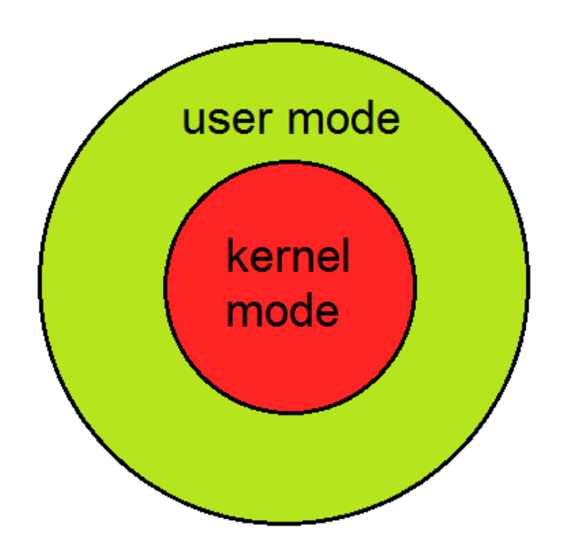
Kernel Mode
When CPU is in kernel mode, the code being executed can access any memory address and any hardware resource.
Hence kernel mode is a very privileged and powerful mode.
If a program crashes in kernel mode, the entire system will be halted.
User Mode
When CPU is in user mode, the programs don't have direct access to memory and hardware resources.
In user mode, if any program crashes, only that particular program is halted.
That means the system will be in a safe state even if a program in user mode crashes.
Hence, most programs in an OS run in user mode.

Slide 29
SYSTEM CALLS
When a program in user mode requires access to RAM or a hardware resource, it must ask the kernel to provide access to that resource. This is done via something called a system call.
When a program makes a system call, the mode is switched from user mode to kernel mode. This is called a context switch.
Then the kernel provides the resource which the program requested. After that, another context switch happens which results in change of mode from kernel mode back to user mode.
Generally, system calls are made by the user level programs in the following situations:
Creating, opening, closing and deleting files in the file system.
Creating and managing new processes.
Creating a connection in the network, sending and receiving packets.
Requesting access to a hardware device, like a mouse or a printer.

Slide 31
SYSTEM CALLS

Slide 32
TYPES OF SYSTEM CALLS
System calls can be grouped roughly in to five categories:
Process control
File management
Device management
Information maintenance
Communications

Slide 33
SYSTEM STRUCTURE
A system as large and complex as a modern operating system must be engineered carefully if it is to function properly and be modified easily.
A common approach is to partition the task into small components rather than have one monolithic system.
There are four different structures that have shown in this document in order to get some idea of the spectrum of possibilities.
These are by no means exhaustive, but they give an idea of some designs that have been tried in practice.
REFER SLIDES : 16,17,18,19,20,21,22

Slide 34
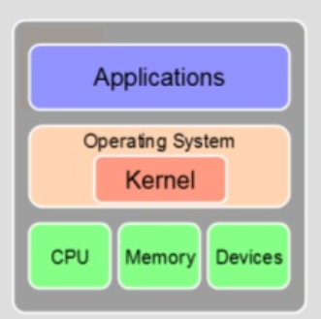
KERNELS
The fundamental part of an Operating system
Responsible for providing secure access to the machine’s hardware for various programs
Responsible for deciding when and how long a program can use a certain hardware.
TYPES:
Monolithic kernel
Micro kernel
Hybrid kernels
Nano kernels
Exo kernels

Slide 35
RESOURCES & PROCESSES
RESOURCES
The OS treats an entity as a resource if it satisfies the below characteristics:
A process must request it from the OS.
A process must suspend its operation until the entity is allocated to it.
The most common source is a file. A process must request a file before it can read it or write it.
FILES:
A sequential file is a named, linear stream bytes of memory.
You can store information by opening a file

Slide 36
RESOURCES & PROCESSES
PROCESS
A program in execution; process execution must progress in sequential fashion.
A process is a program execution in OS
A process is more than the program code, which is sometimes known as the text section.
A process includes:
Program counter -- The current activity, as represented by the value of the Program counter and the contents of the processor's registers.
Stack -- The process Stack contains temporary data (such as function parameters, return addresses, and local variables)
Data section -- Data section, which contains global variables.

Slide 37
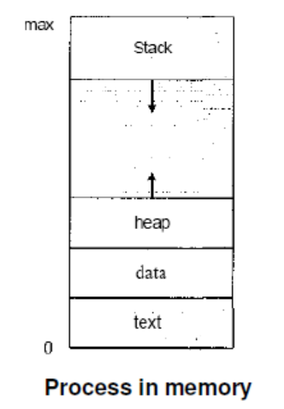
RESOURCES & PROCESSES
A process may also include a heap, which is memory that is dynamically allocated during process run time

Slide 38
THREADS
A thread is a flow of execution through the process code, with its own program counter
A thread shares with its peer threads few information like code segment, data segment and open files.
A thread is a basic unit of CPU utilization. A thread, sometimes called as light weight process whereas a process is a heavyweight process.
Thread comprises:
A thread ID
A program counter
A register set
A stack.

Slide 39
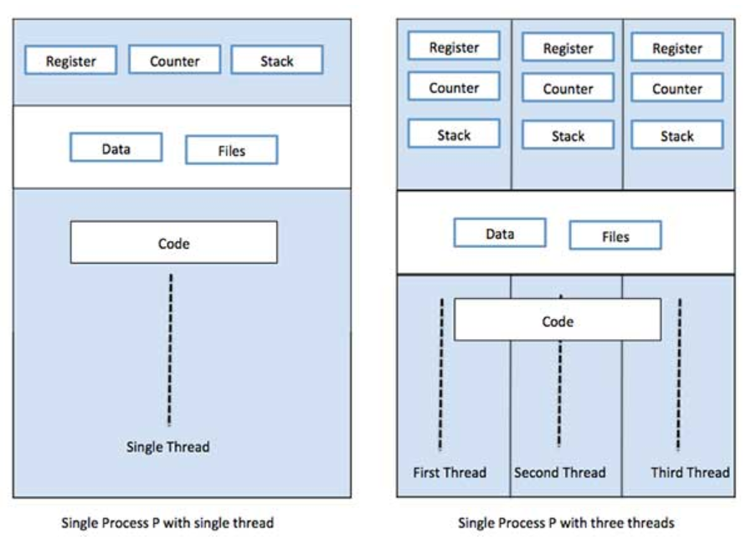

Slide 40
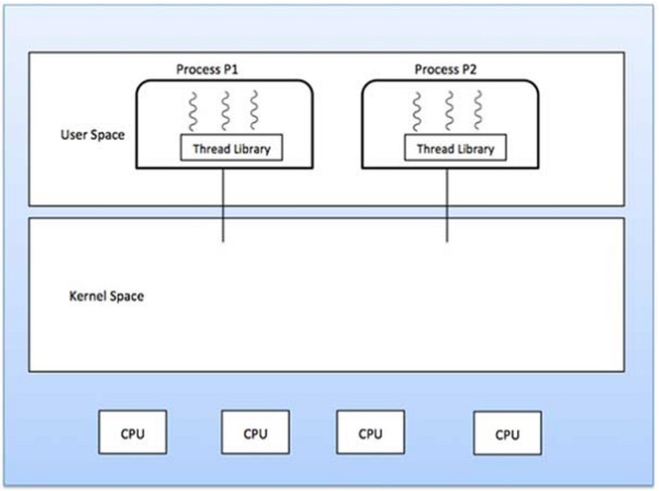
TYPES OF THREADS
User Level Threads − User managed threads.
Kernel Level Threads − Operating System managed threads acting on kernel, an operating system core.
USER LEVEL THREADS

Slide 41
KERNEL LEVEL THREADS
Kernel threads are supported and managed directly by the operating system.
Any application can be programmed to be multithreaded. All of the threads within an application are supported within a single process.
MULTI THREADING MODELS
Many systems provide support for both user and kernel threads, resulting in different multithreading models. Three common ways of establishing this relationship are:
Many to many relationship.
Many to one relationship.
One to one relationship.

Slide 42
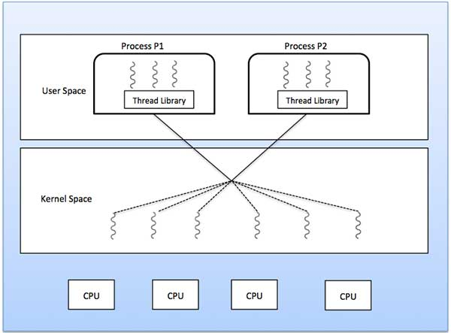
MANY TO MANY MODEL

Slide 43
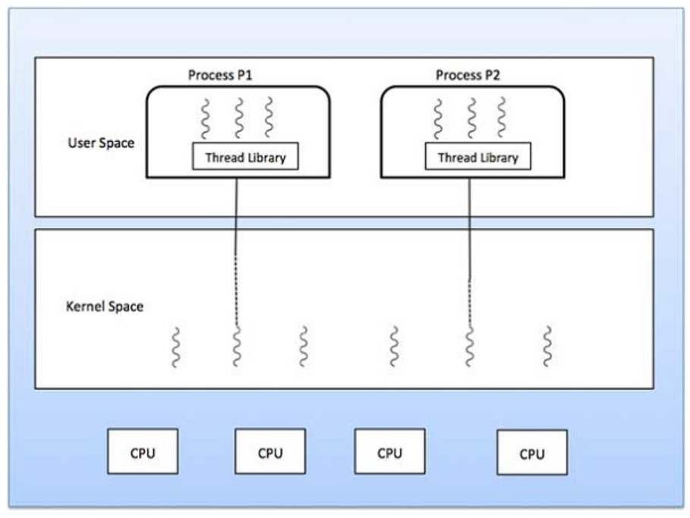
MANY TO ONE MODEL

Slide 44
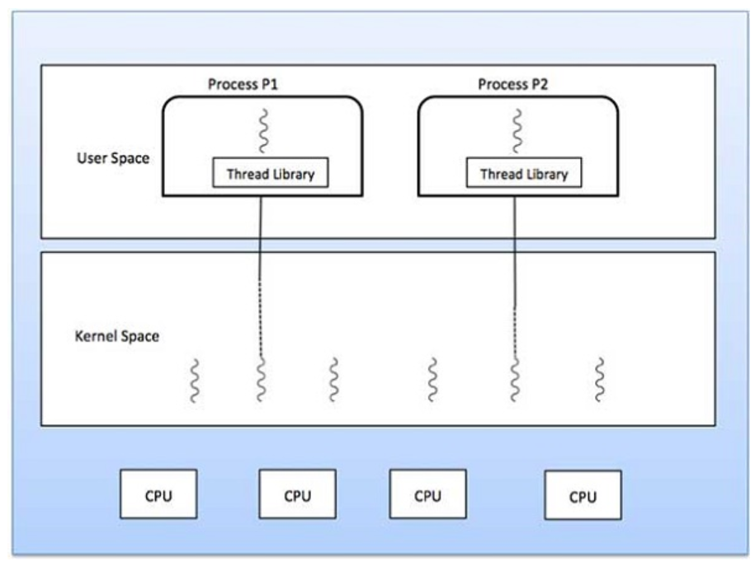
ONE TO ONE MODEL

Slide 45
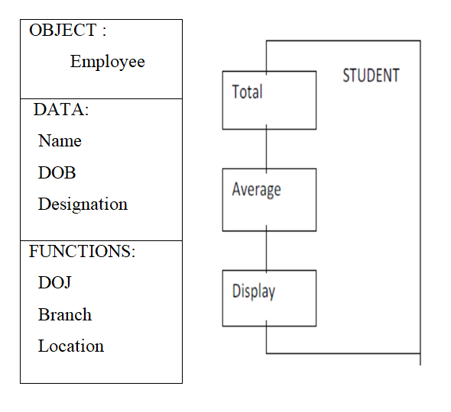
OBJECTS
Objects are the basic run time entities in an object-oriented system.
They may represent a person, a place, a bank account, a table of data or any item that the program has to handle.

Slide 46
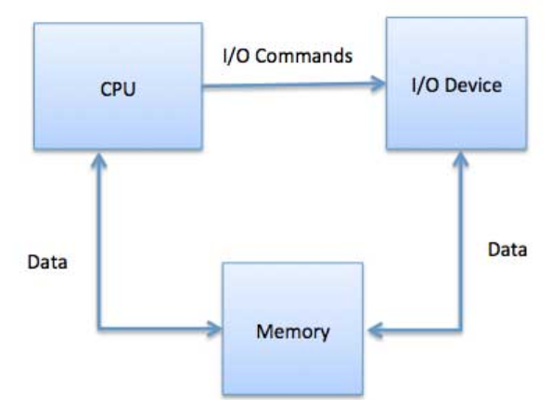
DEVICE MANAGEMENT
This component of operating system manages hardware devices via their respective drivers

Slide 47
DIRECT I/O
Direct I/O – CPU software explicitly transfer data to and from the controller’s data registers
Direct I/O with polling – the device management software polls the device controller status register to detect completion of the operation;
Interrupt driven direct I/O – interrupts simplify the software’s responsibility for detecting operation completion;

Slide 48
MEMORY MAPPED I/O
Memory mapped I/O – device addressing simplifies the interface (device seen as a range of memory locations)
Memory mapped I/O with polling – the device management software polls the device controller status register to detect completion of the operation;
Interrupt driven I/O – interrupts simplify the software’s responsibility for detecting operation completion;

Slide 49
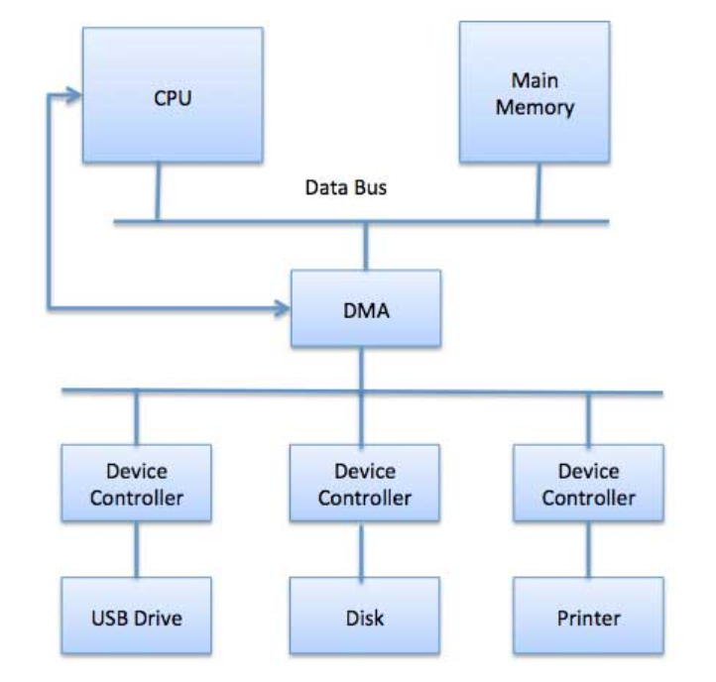
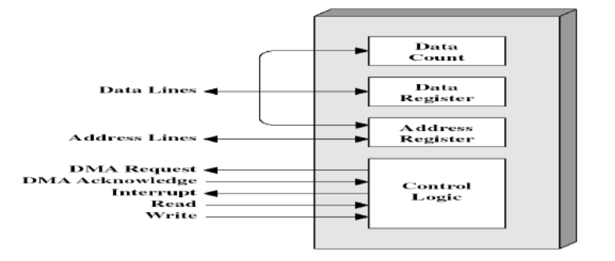
DIRECT MEMORY ACCESS
Involves designing of hardware to avoid the CPU perform the transfer of information between the device

Slide 50
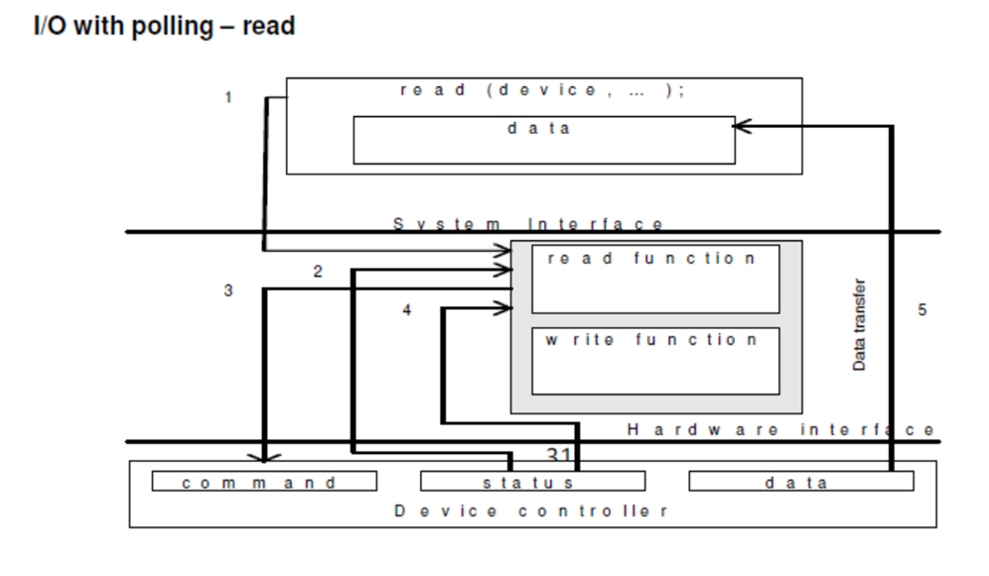

Slide 51
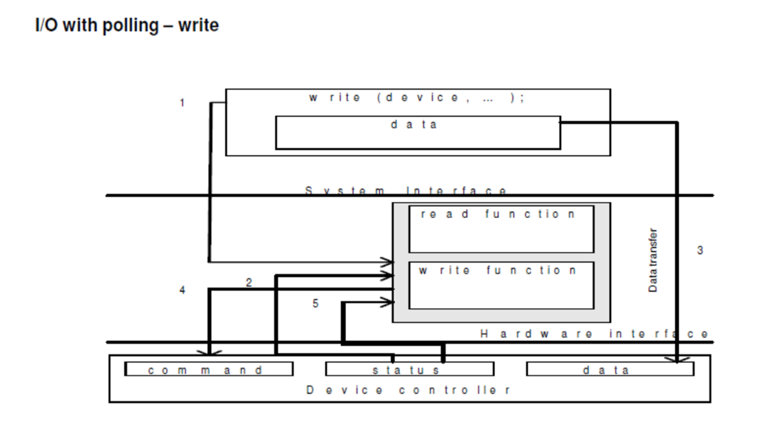

Slide 52
BUFFERING
Buffering is a technique by which a device manager keeps the slower I/O devices busy when a process is not requiring I/O operations.
Input buffering is the process of reading the data into the primary memory before the process requests it.
Output buffering is the process of saving the data in the memory and then writing it to the device while the process continues its execution.

Slide 53
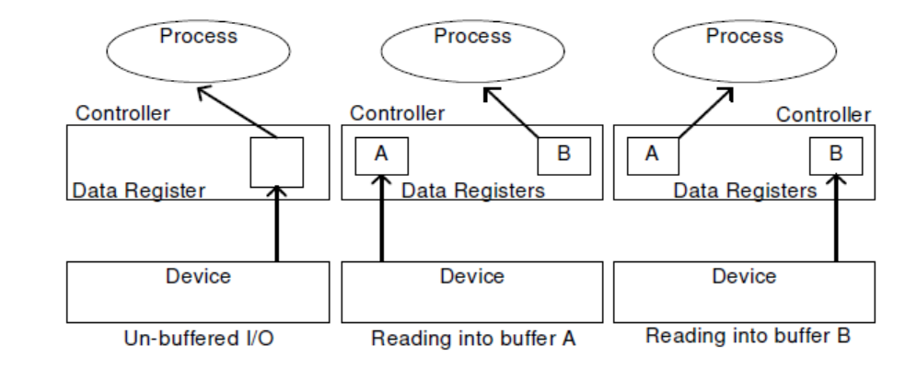
HARDWARE LEVEL BUFFERING

Slide 54
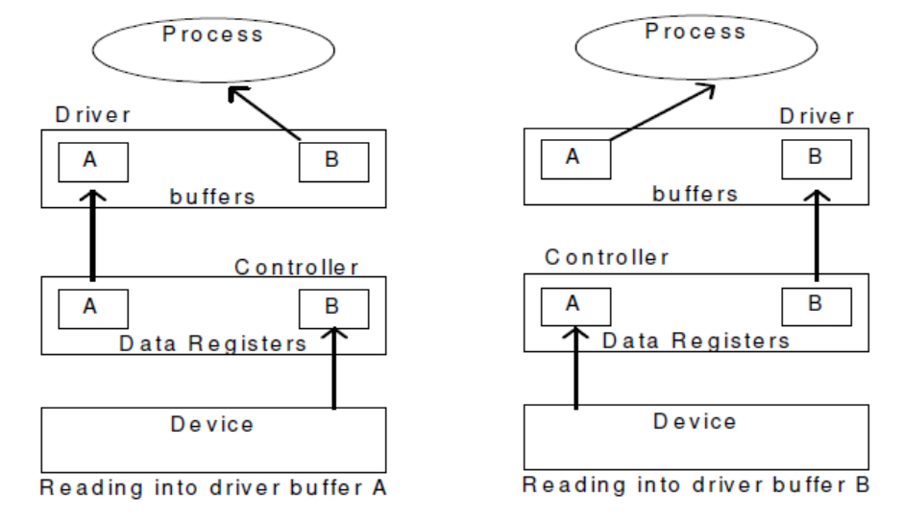
DRIVER LEVEL BUFFERING

Slide 55
DEVICE DRIVER
It is a software program that controls a particular type of device attached to the computer.
It provides an interface to the hardware devices without the requirement to know the precise information about the hardware.
A device driver communicates with the device through a bus or communication sub system.
RESPONSIBLITIES
Initialize devices
Interpreting the commands from the operating system
Manage data transfers
Accept and process interrupts
Maintain the integrity of driver and kernel data structures

Slide 56
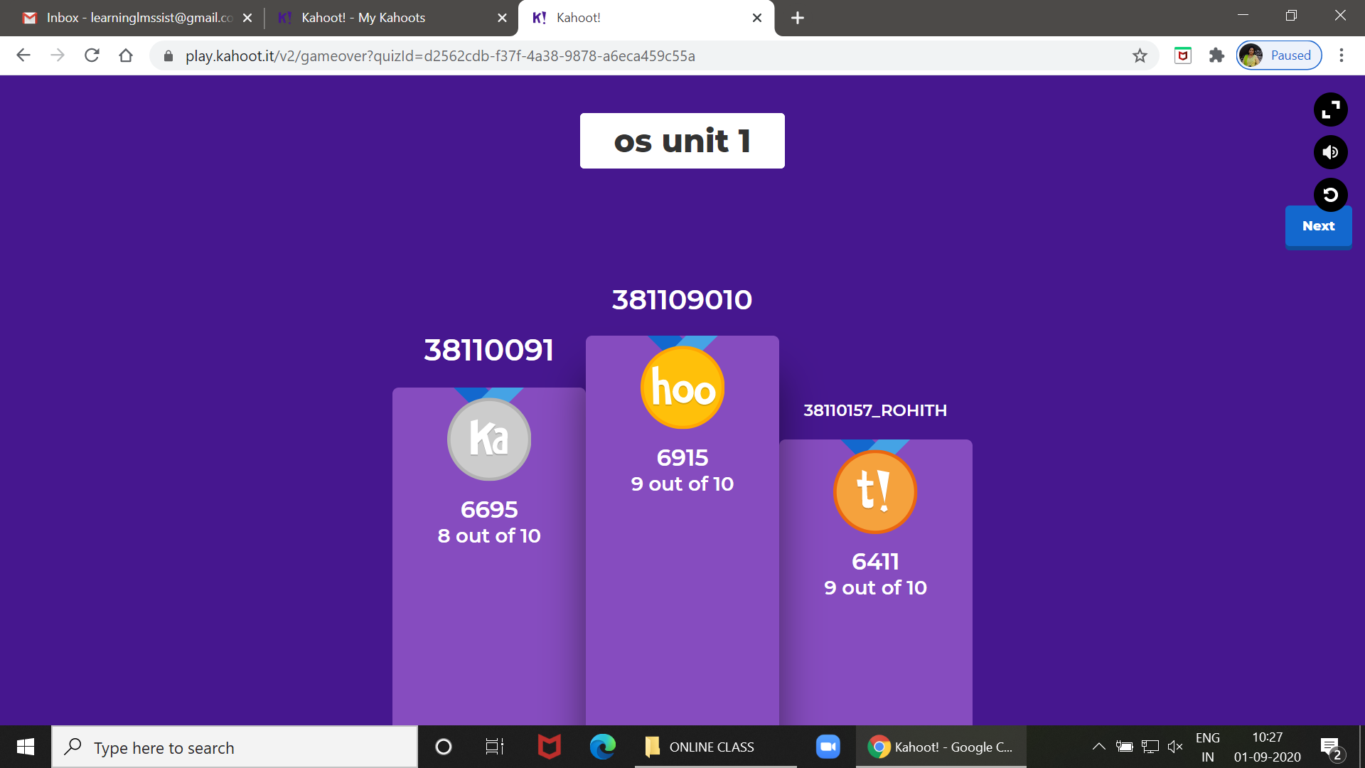
Quiz – A - 132

Slide 57

Quiz – C - 105

